Slide 1
Introduction to
Bayesian Statistics
Generalised linear models &
hierarchical models
Doug Leasure
Senior Researcher and Data Scientist
Demographic Science Unit
Dept. Population Health
University of Oxford

Slide 2
Outline
General linear model (refresher)
Generalised linear models (GLMs)
Mark-recapture
Hierarchical models
State-space

Slide 3
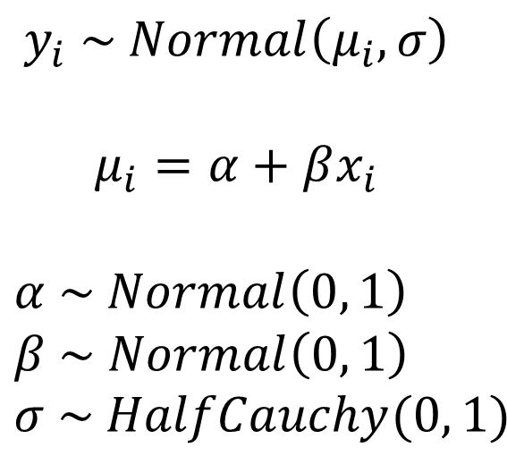
Components of a model
$$y_{i} \sim Normal\left(μ_{i}, σ\right)$$
$$μ_{i}=α+βx_{i}$$
$$α \sim Normal\left(0, 1\right) \\ β \sim Normal\left(0, 1\right) \\ σ \sim HalfCauchy(0, 1)$$
  Data model(s)
  Process model(s)
  Parameter model(s)

Slide 4
Diagnostics
MCMC Diagnostics
  Trace plots
  Rhat
Model fit
  Out-of-sample cross validation
  Posterior predictive checks
  (your normal way of assessing fit for any other statistical model)

Slide 5
Linear regression
General linear model

Slide 6
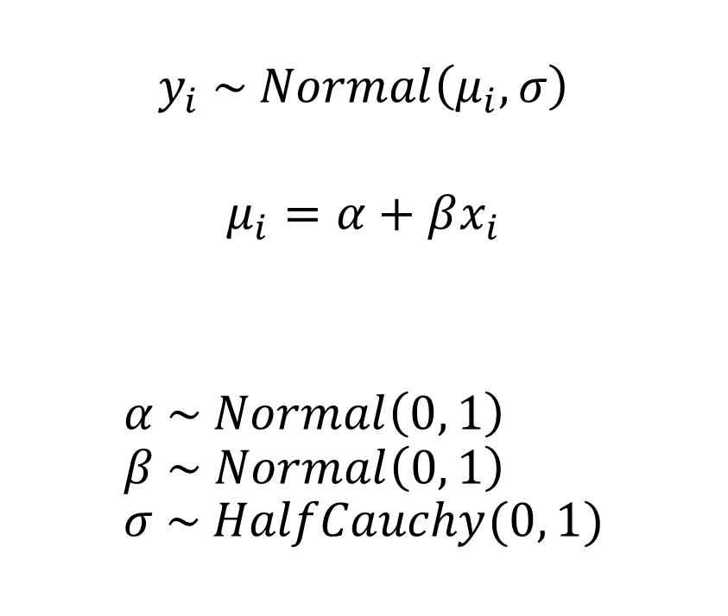
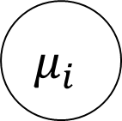
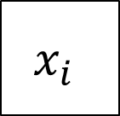
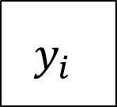
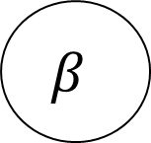
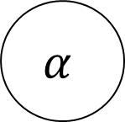
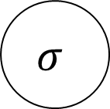
General linear model
Refresher
$$y_{i} \sim Normal\left(μ_{i}, σ\right)$$
$$μ_{i}=α+βx_{i}$$
$$α \sim Normal\left(0, 1\right) \\ β \sim Normal\left(0, 1\right) \\ σ \sim HalfCauchy(0, 1)$$
$$x_{i}$$
$$y_{i}$$
$$μ_{i}$$
$$σ$$
$$α$$
$$β$$

Slide 7
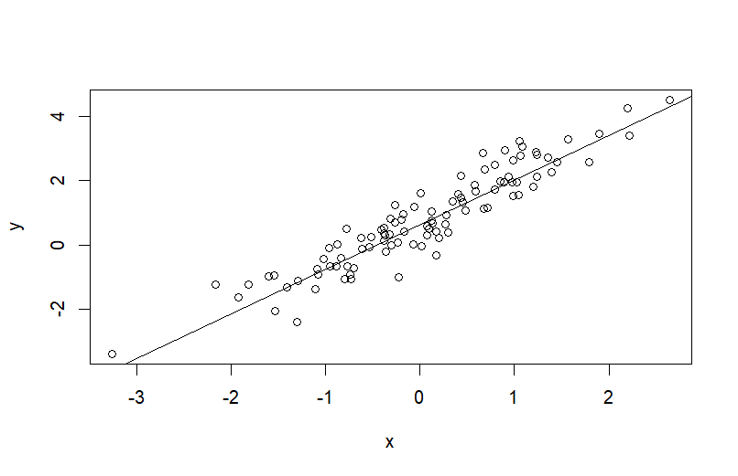
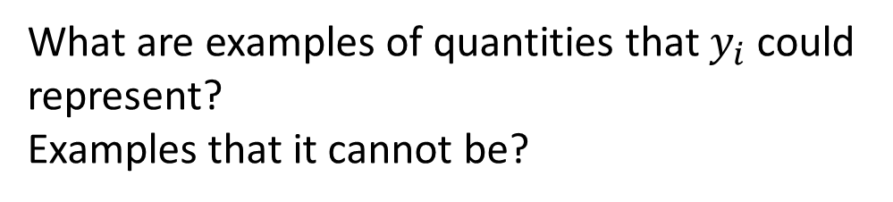
General linear model
Refresher
What are examples of quantities that $y_{i}$ could represent?
Examples that it cannot be?
$$y_{i} \sim Normal\left(μ_{i}, σ\right)$$
$$μ_{i}=α+βx_{i}$$
$$α \sim Normal\left(0, 1\right) \\ β \sim Normal\left(0, 1\right) \\ σ \sim HalfCauchy(0, 1)$$

Slide 8
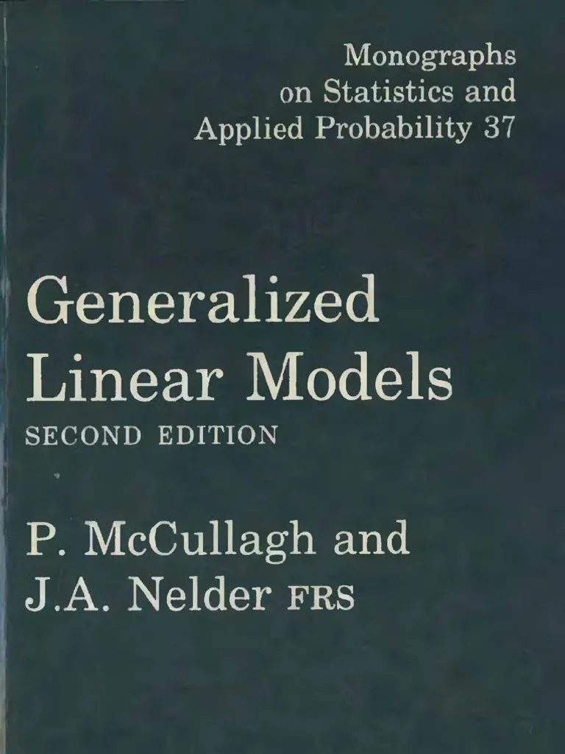
Generalised linear models

Slide 9
Generalised linear models
Generalisation of a linear model to accommodate additional data types
Three components:
  Probability distribution
  A linear predictor
  Link function

Slide 10
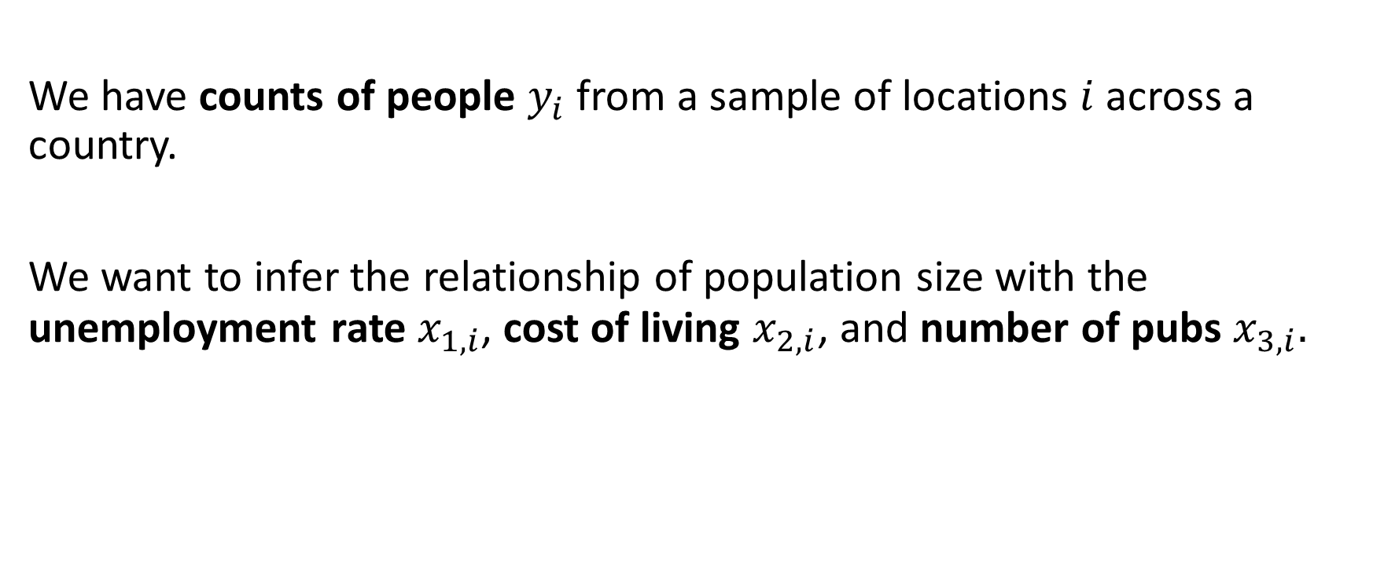
Can you sketch a model?
We have counts of people $y_{i}$from a sample of locations $i$ across a country.
We want to infer the relationship of population size with the unemployment rate $x_{1,i}$, cost of living $x_{2,i}$, and number of pubs $x_{3,i}.$

Slide 11

Generalised linear model
Poisson regression for count data
$$y_{i} \sim Poisson\left(λ_{i}\right)$$
$${log⁡(λ}_{i})=α+\sum_{k=1}^{K}{β_{k}x_{k,i}}$$
$$α \sim Normal\left(0, 15\right) \\ β \sim Normal(0, 10)$$

Slide 12
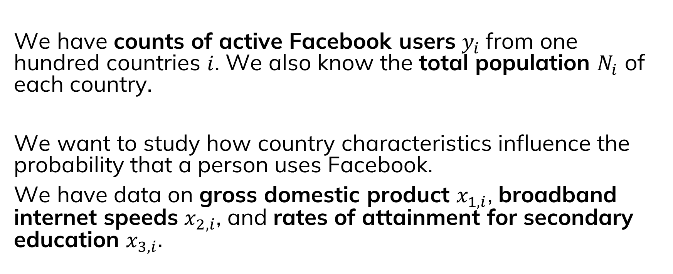
Can we build a model for these data?
We have counts of active Facebook users $y_{i}$from one hundred countries $i$. We also know the total population $N_{i}$ of each country.
We want to study how country characteristics influence the probability that a person uses Facebook.
We have data on gross domestic product $x_{1,i}$, broadband internet speeds $x_{2,i}$, and rates of attainment for secondary education $x_{3,i}.$

Slide 13

Generalised linear model
Binomial regression for count data
$$y_{i} \sim Binomial\left(N_{i}, θ_{i}\right)$$
$$logit\left(θ_{i}\right)=α+\sum_{k=1}^{K}{β_{k}x_{k,i}}$$
$$α \sim Normal\left(0, 1e3\right) \\ β \sim Normal(0, 1e3)$$

Slide 14
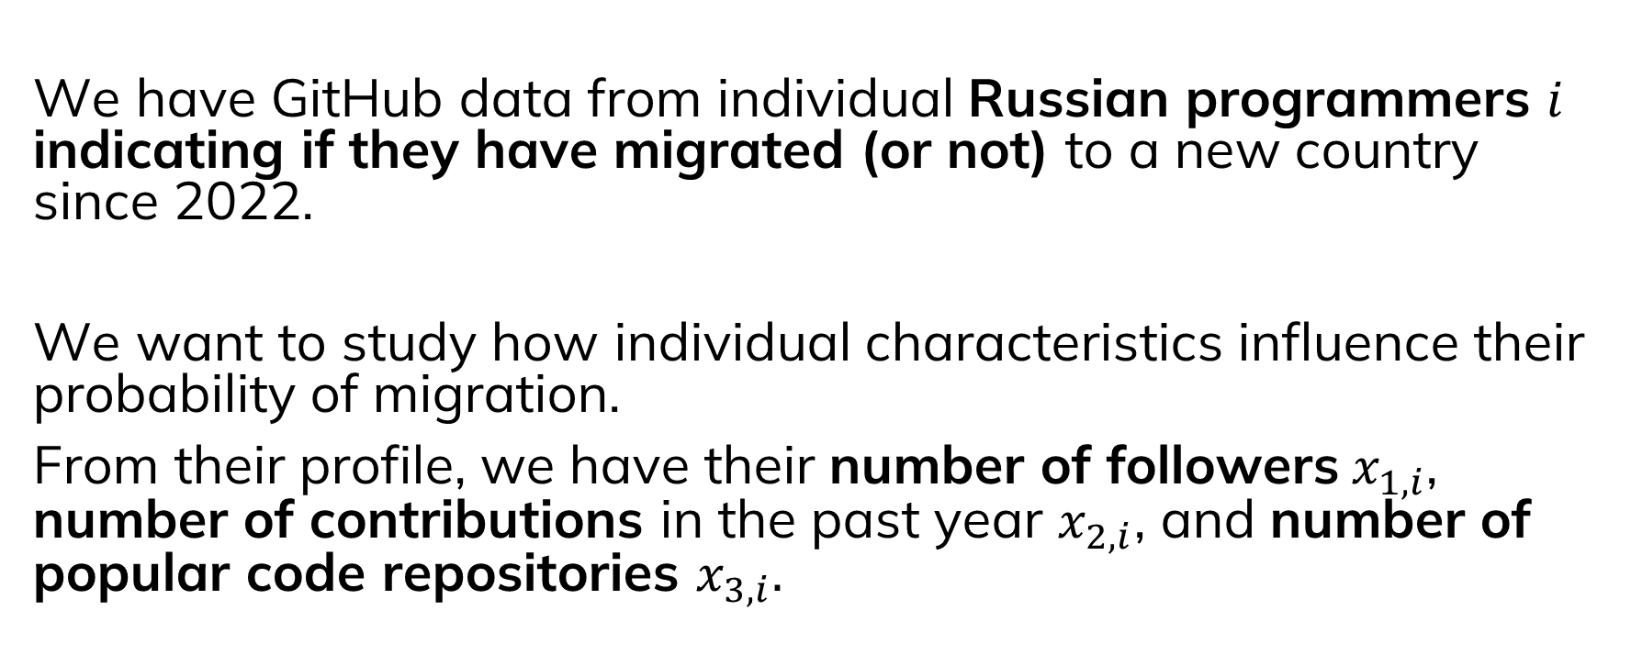
How about this one?
We have GitHub data from individual Russian programmers $i$ indicating if they have migrated (or not) to a new country since 2022.
We want to study how individual characteristics influence their probability of migration.
From their profile, we have their number of followers$x_{1,i}$, number of contributions in the past year $x_{2,i}$, and number of popular code repositories $x_{3,i}.$

Slide 15

Generalised linear model
Logistic regression for binary outcomes
$$y_{i} \sim Bernoulli\left(θ\right)$$
$$logit\left(θ\right)=α+\sum_{k=1}^{K}{β_{k}x_{k,i}}$$
$$α \sim Normal\left(0, 1e3\right) \\ β \sim Normal(0, 1e3)$$

Slide 16
Some other useful models beyond GLMs…

Slide 17
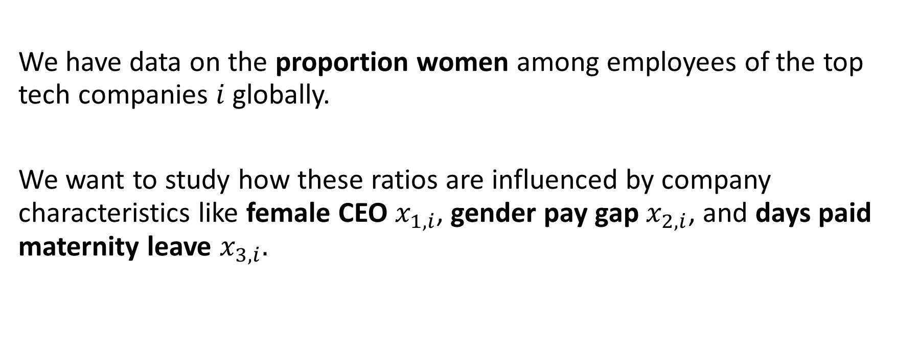
What do you think about this one?
We have data on the proportion women among employees of the top tech companies $i$ globally.
We want to study how these ratios are influenced by company characteristics like female CEO $x_{1,i}$, gender pay gap $x_{2,i}$, and days paid maternity leave $x_{3,i}.$

Slide 18

Beta regression
$$y_{i} \sim Beta\left(μτ,τ−μ_{i}τ\right)$$
$${logit(μ}_{i})=α+\sum_{k=1}^{K}{β_{k}x_{k,i}}$$
$$α \sim Normal\left(0, 1e3\right)$$
$$β \sim Normal(0, 1e3)$$
$$τ \sim Uniform(0, 1e3)$$

Slide 19
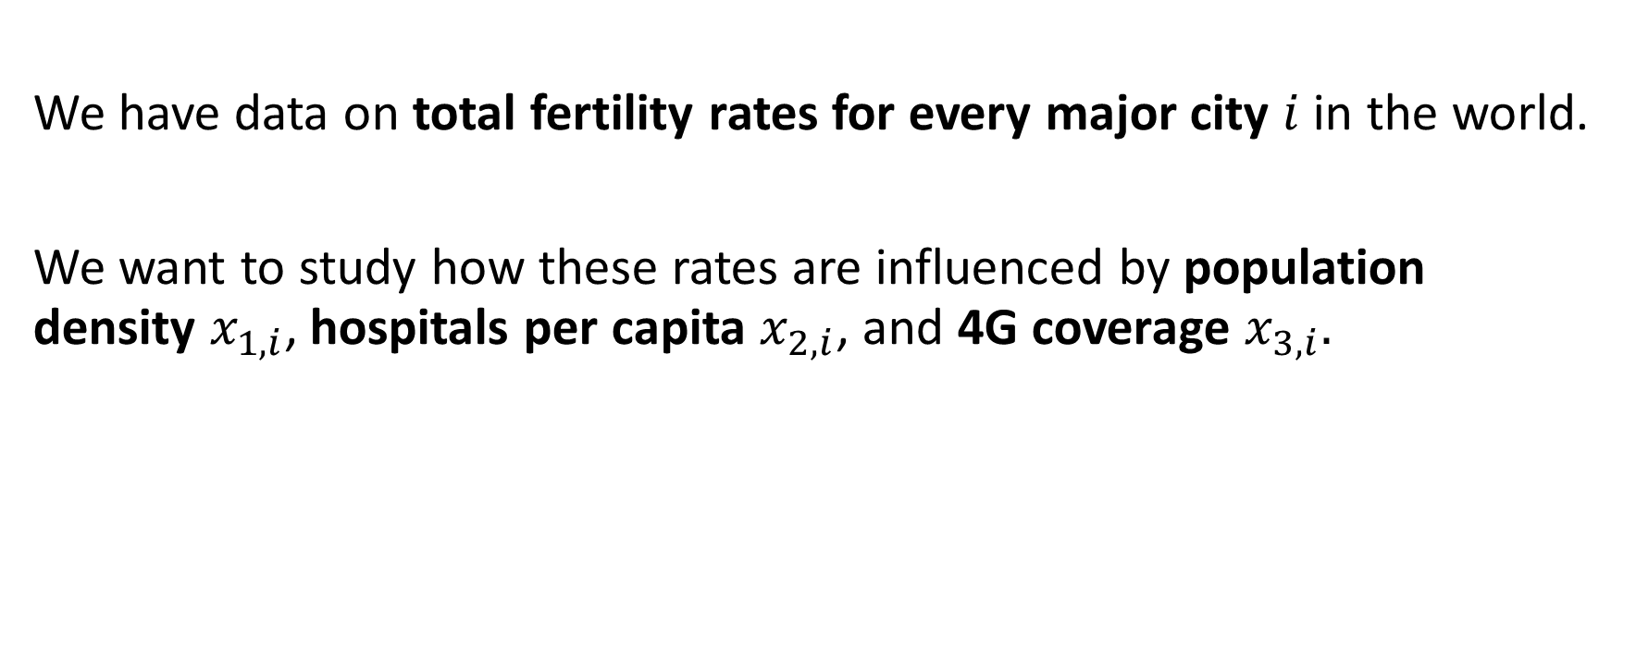
Last one…
We have data on total fertility rates for every major city $i$ in the world.
We want to study how these rates are influenced by population density $x_{1,i}$, hospitals per capita $x_{2,i}$, and 4G coverage $x_{3,i}.$

Slide 20

Log-linear regression
$$y_{i} \sim LogNormal\left(μ_{i}, σ\right)$$
$$μ_{i}=α+\sum_{k=1}^{K}{β_{k}x_{k,i}}$$
$$α \sim Normal\left(0, 1e3\right) \\ β \sim Normal(0, 1e3)$$
$$σ \sim HalfNormal(0, 1)$$
What if we also wanted to include a country effect?
How would you do that?

Slide 21
Hierarchical Models

Slide 22
Hierarchical models
Multiple levels (i.e. sub-models) within the same model
The outcome of one level is an input to another level
Why do we want to do this?
Sharing information among groups to increase statistical power
Processes occurring at multiple scales (i.e. spatial, temporal, etc)
Partition uncertainty into process error and observation error
Different deterministic functions (i.e. regressions) for different levels of the model

Slide 23
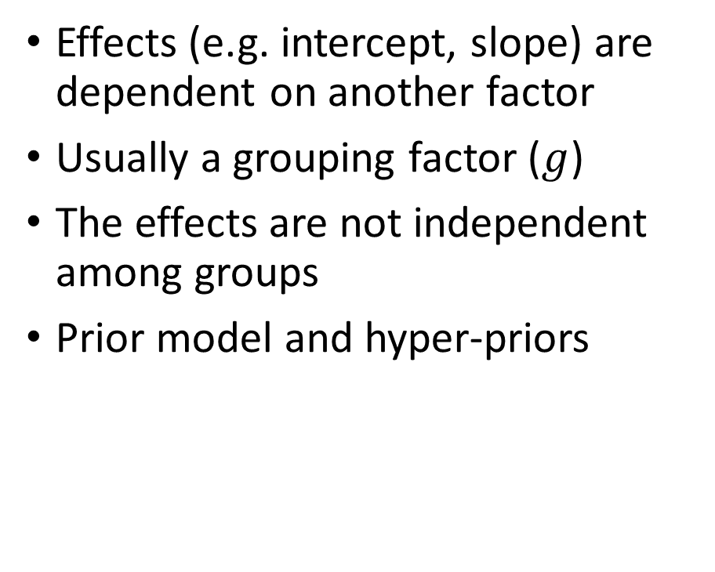
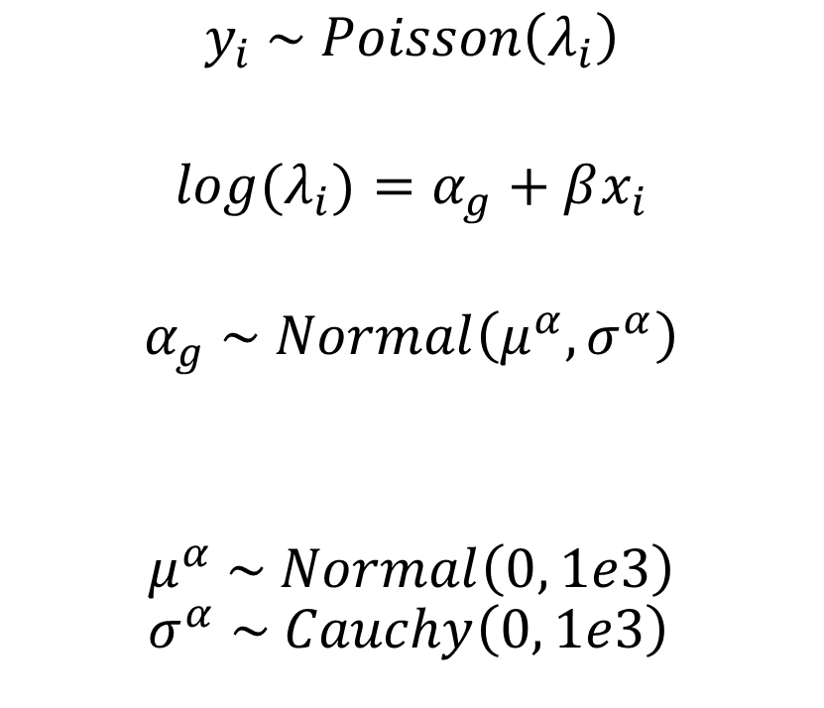
Random effects
Effects (e.g. intercept, slope) are dependent on another factor
Usually a grouping factor ($g$)
The effects are not independent among groups
Prior model and hyper-priors
$$y_{i} \sim Poisson\left(λ_{i}\right)$$
$$log⁡(λ_{i})=α_{g}+βx_{i}$$
$$α_{g} \sim Normal\left(μ^{α}, σ^{α}\right)$$
$$μ^{α} \sim Normal\left(0, 1e3\right) \\ σ^{α} \sim Cauchy\left(0, 1e3\right)$$
Gelman A. 2006. Prior distributions for variance parameters in hierarchical models. Bayesian Analysis 1(3):515-533.

Slide 24








Random effects
$$y_{i} \sim Poisson\left(λ_{i}\right)$$
$$log⁡(λ_{i})=α_{g}+βx_{i}$$
$$α_{g} \sim Normal\left(μ^{α}, σ^{α}\right)$$
$$μ^{α} \sim Normal\left(0, 1e3\right) \\ σ^{α} \sim Cauchy\left(0, 1e3\right)$$
$${group}_{i}$$
$$x_{i}$$
$$y_{i}$$
$$α_{g}$$
$$λ_{i}$$
$$μ^{α}$$
$$σ^{α}$$
$$β$$
Gelman A. 2006. Prior distributions for variance parameters in hierarchical models. Bayesian Analysis 1(3):515-533.

Slide 25
Mark-recapture
A method originally designed for estimating unobservable animal populations
Useful in demography for estimating populations that are impossible to census
Lincoln-Peterson mark recapture in the oldest and simplest approach (assuming a closed population)
Cormack-Jolly-Seber method is an open-population method in which the population can change due to mortality.
“Multi-systems estimation” is a based on these approaches and has been used to estimate casualties from armed conflicts (including unobserved casualties).
Manrique-Vallier et al. 2021. Capture-recapture for casualty estimation and beyond: Recent advances and research directions. Chapter in Statistics in the Public Interest. Pp. 15-31. Springer.
Stan User’s Guide. Mark-recapture models. https://mc-stan.org/docs/stan-users-guide/latent-discrete.html#mark-recapture-models

Slide 26

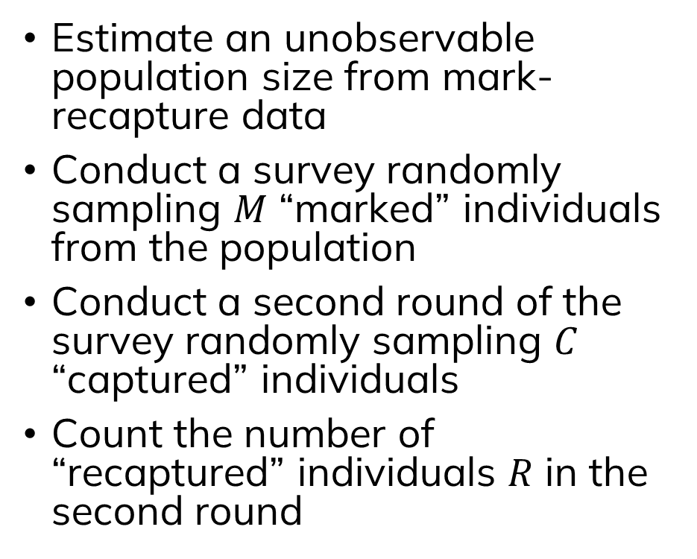
Mark-recapture model
(Lincoln-Peterson)
Estimate an unobservable population size from mark-recapture data
Conduct a survey randomly sampling $M$ “marked” individuals from the population
Conduct a second round of the survey randomly sampling $C$ “captured” individuals
Count the number of “recaptured” individuals $R$ in the second round
$$R \sim Binomial\left(C,\frac{M}{N}\right)$$
$$N \sim Uniform(C−R+M, 1e6)$$

Slide 27

Mark-recapture model (Lincoln-Peterson)
survey = 1, mogwai = 10
$$R \sim Binomial\left(C,\frac{M}{N}\right)$$
$$N \sim Uniform(C−R+M, 1e6)$$

Slide 28
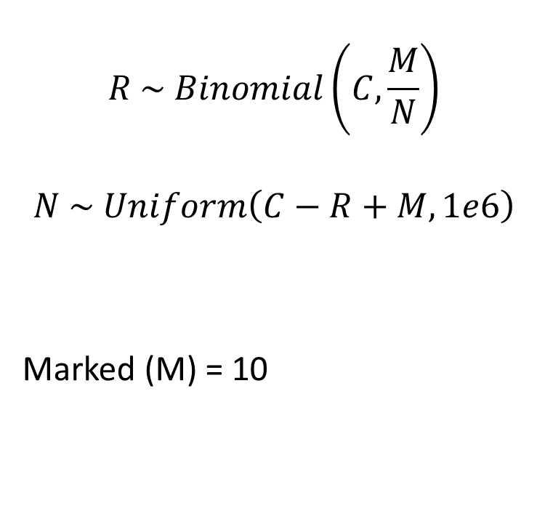
Mark-recapture model (Lincoln-Peterson)
survey = 1, mogwai = 10
$$R \sim Binomial\left(C,\frac{M}{N}\right)$$
$$N \sim Uniform\left(C−R+M, 1e6\right)$$
Marked (M) = 10

Slide 29
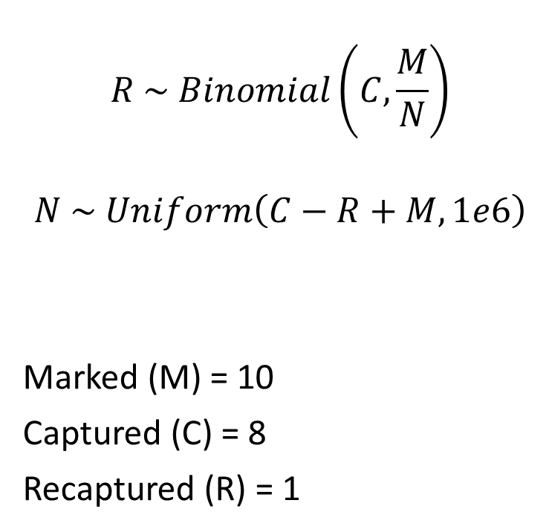
Mark-recapture model (Lincoln-Peterson)
survey = 2, mogwai = 8
$$R \sim Binomial\left(C,\frac{M}{N}\right)$$
$$N \sim Uniform\left(C−R+M, 1e6\right)$$
Marked (M) = 10
Captured (C) = 8
Recaptured (R) = 1

Slide 30
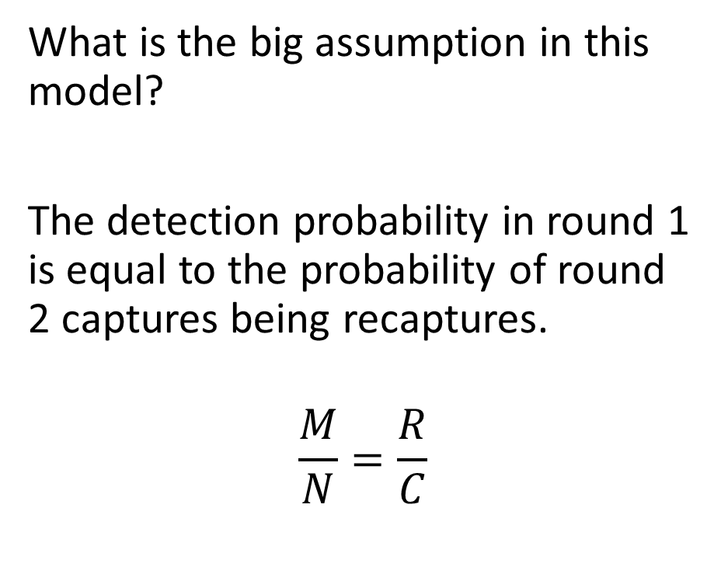
Mark-recapture model (Lincoln-Peterson)
What is the big assumption in this model?
The detection probability in round 1 is equal to the probability of round 2 captures being recaptures.
$$\frac{M}{N}=\frac{R}{C}$$
$$R \sim Binomial\left(C,\frac{M}{N}\right)$$
$$N \sim Uniform(C−R+M, 1e6)$$

Slide 31
Sometimes we can’t “mark” individuals
A “mark” could simply be recording a person’s name and birthdate, but sometimes this is not possible.

Slide 32
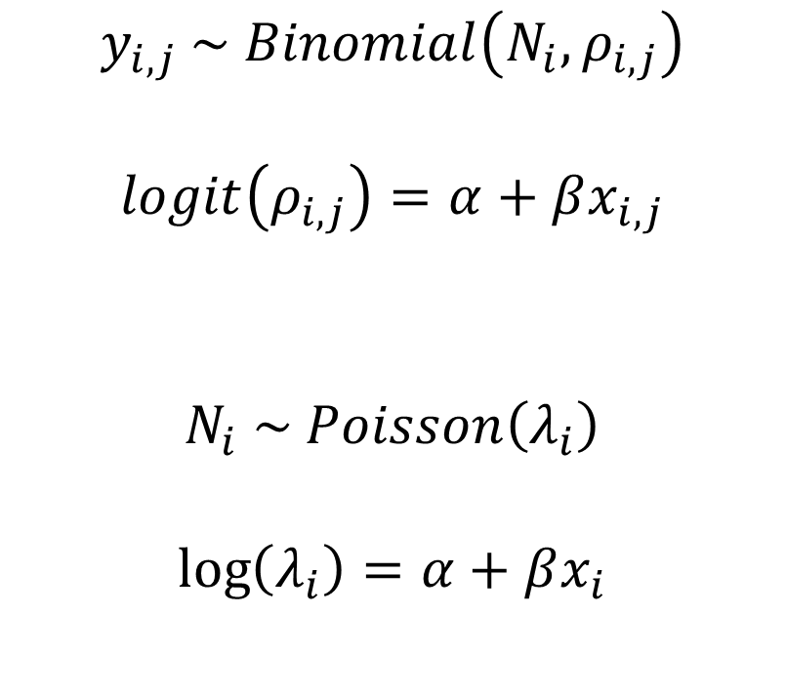
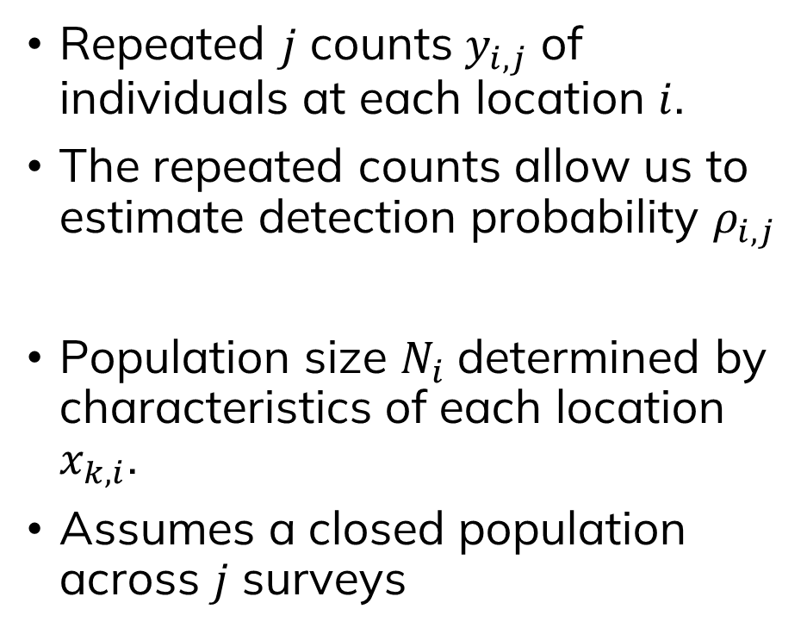
N-mixture models of population size
Repeated $j$ counts $y_{i,j}$ of individuals at each location $i$.
The repeated counts allow us to estimate detection probability $ρ_{i,j}$
Population size $N_{i}$ determined by characteristics of each location $x_{k,i}$.
Assumes a closed population across $j$ surveys
$$y_{i,j} \sim Binomial\left(N_{i}, ρ_{i,j}\right)$$
$$logit\left(ρ_{i,j}\right)=α+βx_{i,j}$$
$$N_{i} \sim Poisson\left(λ_{i}\right)$$
$$\log\left(λ_{i}\right)=α+βx_{i}$$
Royle A. 2004. N-mixture models for estimating population size from spatially replicated counts. Biometrics 60(1):108-115.

Slide 33

N-mixture models of population size
location (i) = 1, survey (j) = 1
mogwai = 6
$y_{1,1}=6$
Royle A. 2004. N-mixture models for estimating population size from spatially replicated counts. Biometrics 60(1):108-115.

Slide 34

N-mixture models of population size
location (i) = 1, survey (j) = 2
mogwai = 9
$y_{1, 1}=6$
$y_{1,2}=9$
Royle A. 2004. N-mixture models for estimating population size from spatially replicated counts. Biometrics 60(1):108-115.

Slide 35

N-mixture models of population size
location (i) = 1, survey (j) = 3
mogwai = 4
$y_{1, 1}=6$
$y_{1,2}=9$
$y_{1,3}=4$
Royle A. 2004. N-mixture models for estimating population size from spatially replicated counts. Biometrics 60(1):108-115.

Slide 36
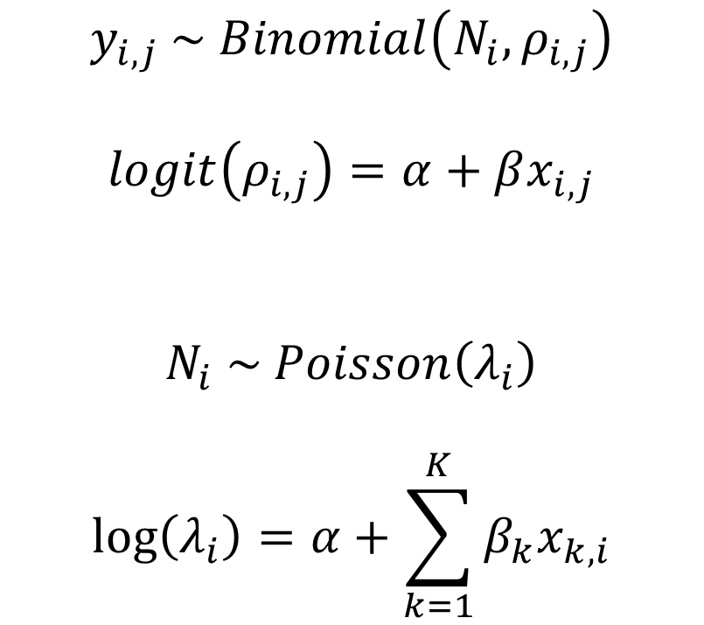
N-mixture models of population size
Observation model:
Process model:
$$y_{i,j} \sim Binomial\left(N_{i}, ρ_{i,j}\right)$$
$$logit\left(ρ_{i,j}\right)=α+βx_{i,j}$$
$$N_{i} \sim Poisson\left(λ_{i}\right)$$
$$\log\left(λ_{i}\right)=α+\sum_{k=1}^{K}{β_{k}x_{k,i}}$$
Royle A. 2004. N-mixture models for estimating population size from spatially replicated counts. Biometrics 60(1):108-115.

Slide 37
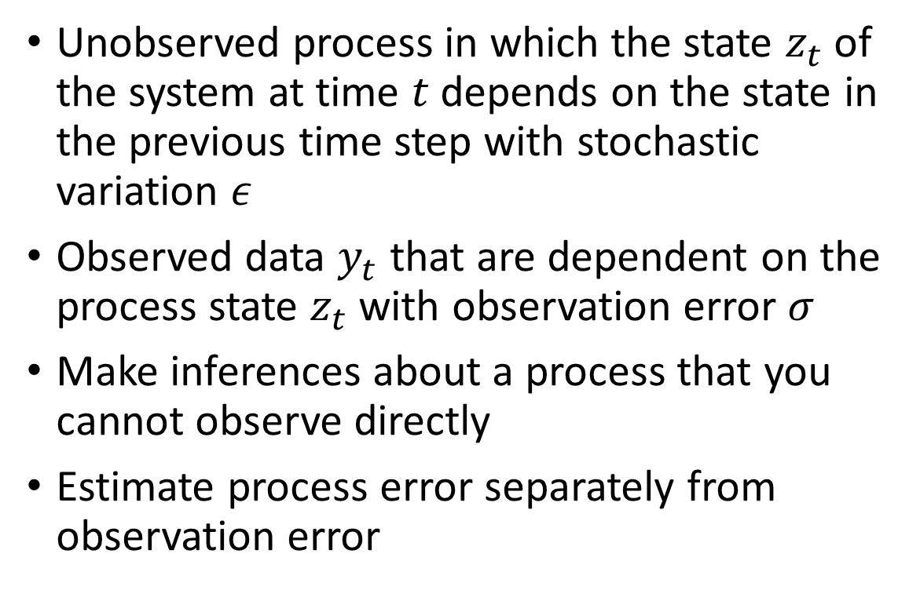

State-space models
Unobserved process in which the state $z_{t}$ of the system at time $t$ depends on the state in the previous time step with stochastic variation $ε$
Observed data $y_{t}$ that are dependent on the process state $z_{t}$ with observation error $σ$
Make inferences about a process that you cannot observe directly
Estimate process error separately from observation error
$${P(z}_{t} \left| {θz}_{t−1}, ε\right)$$
$$P\left(y_{t} \right| βz_{t}, σ)$$

Slide 38
State-space models
Hidden Markov model is a specific case of this
Process model:
Observation model:
$${P(z}_{t} \left| {θz}_{t−1}, ε\right)$$
$$P\left(y_{t} \right| βz_{t}, σ)$$

Slide 39
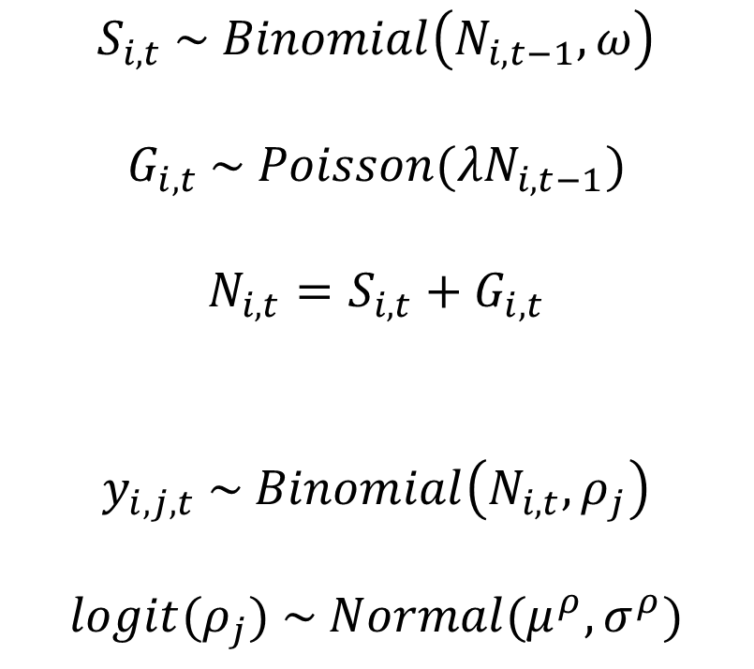
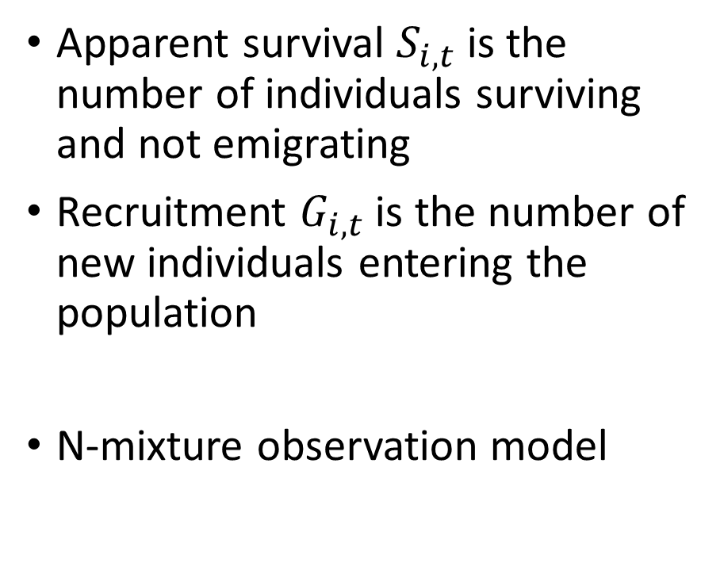
Dail-Madsen open population models
Apparent survival $S_{i,t}$ is the number of individuals surviving and not emigrating
Recruitment $G_{i,t}$ is the number of new individuals entering the population
N-mixture observation model
$$S_{i,t} \sim Binomial\left(N_{i,t−1}, ω\right)$$
$$G_{i,t} \sim Poisson({λN}_{i,t−1})$$
$$N_{i,t}=S_{i,t}+G_{i,t}$$
$$y_{i,j,t} \sim Binomial\left(N_{i,t}, ρ_{j}\right)$$
$${logit(ρ}_{j}) \sim Normal(μ^{ρ},σ^{ρ})$$
Dail & Madsen. 2011. Estimating abundance from repeated counts of an open metapopulation. Biometrics 67:577-587.
Hostetler & Chandler 2015. Improved state-space models for inference about spatial and temporal variation in abundance. Ecology 96(6)

Slide 40
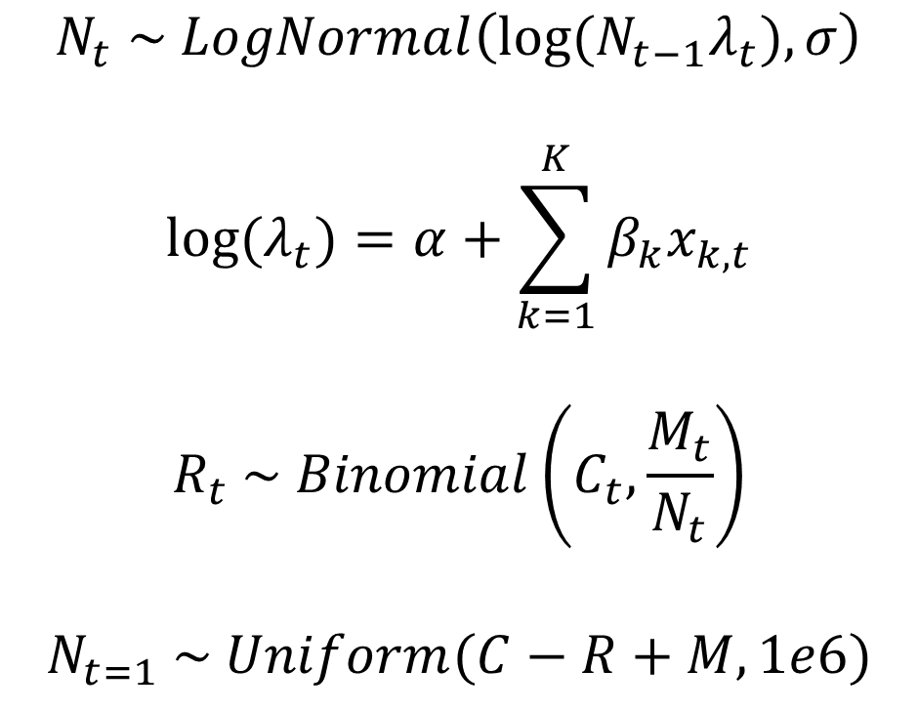
Mark-recapture state-space model
A population process
Why a log-normal? Hmm….
Priors not shown
Mark-recapture observations
A prior is only needed to initialise N in the first time step
$$N_{t} \sim LogNormal\left({log⁡(N}_{t−1}λ_{t}), σ\right)$$
$${log⁡(λ}_{t})=α+\sum_{k=1}^{K}{β_{k}x_{k,t}}$$
$$R_{t} \sim Binomial\left(C_{t},\frac{M_{t}}{N_{t}}\right)$$
$$N_{t=1} \sim Uniform(C−R+M, 1e6)$$

Slide 41
Stan and discrete latent parameters
Stan does not allow parameters to be integers. Only data can be integers.
This is infinitely annoying, but the Stan developers are firm in their crusade against discrete latent parameters in the noble pursuit of accurately estimating the tails of distributions and increasing MCMC efficiency.
If you have a model with a latent discrete parameter (e.g. unobserved population size), then you have three options:
  Re-parameterise your model to “marginalise out” the integer parameter.
  Use a continuous distribution for your integer parameter (e.g. LogNormal).
  Use JAGS instead of Stan.
Stan Users Guide. Latent discrete parameters. https://mc-stan.org/docs/stan-users-guide/latent-discrete.html#latent-discrete.chapter
See Stan Forums for discussion on marginalising out integer parameters for various types of specific models.

Slide 42
Recap
Ordinary linear models
Generalised linear models
  Logistic regression
  Binomial regression
  Poisson regression
Log-linear models
Beta regression
Mark-recapture
Hierarchical Models
Random effects
N-mixture models
State-space
  Dail-Madsen N-mixture
  Mark-recapture state-space

Slide 43
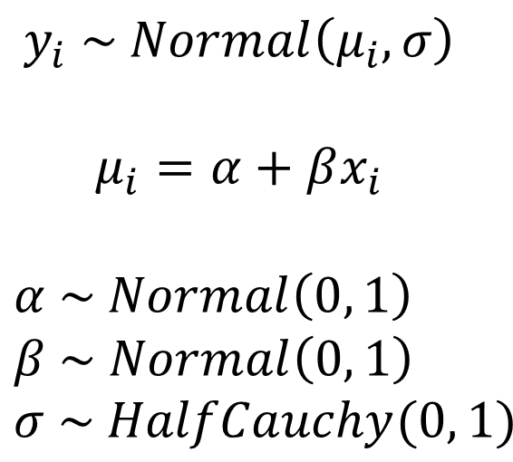
Components of a model
$$y_{i} \sim Normal\left(μ_{i}, σ\right)$$
$$μ_{i}=α+βx_{i}$$
$$α \sim Normal\left(0, 1\right) \\ β \sim Normal\left(0, 1\right) \\ σ \sim HalfCauchy(0, 1)$$
  Data model (likelihood)
  Deterministic process
  Parameter model (e.g. priors)

Slide 44

Tie it all together…
Ordinary linear regression
$$y_{i} \sim Normal\left(μ_{i}, σ\right)$$
$$μ_{i}=α+βx_{i}$$
Priors not shown

Slide 45

Tie it all together…
Generalised linear model
$$y_{i} \sim Poisson\left(λ_{i}\right)$$
$$log⁡(λ_{i})=α+βx_{i}$$
Priors not shown

Slide 46

Tie it all together…
Generalised linear model
$$y_{i} \sim Binomial\left(N_{i}, ρ_{i}\right)$$
$$logit(ρ_{i})=α+βx_{i}$$
Priors not shown

Slide 47

Tie it all together…
Random effects (hierarchical model)
$$y_{i} \sim Binomial\left(N_{i}, ρ_{i}\right)$$
$$logit\left(ρ_{i}\right)=α_{g}+βx_{i}$$
$$a_{g} \sim Normal(μ, σ)$$
Priors not shown

Slide 48

Tie it all together…
Hierarchical models (e.g. N-mixture model)
$$N_{i} \sim Poisson\left(λ_{i}\right)$$
$$\log\left(λ_{i}\right)=α+βx_{i}$$
$$y_{i,j} \sim Binomial\left(N_{i}, ρ_{i,j}\right)$$
$$logit\left(ρ_{i,j}\right)=α+βx_{i,j}$$
Latent process model:
Observation model:
Priors not shown

Slide 49

Tie it all together…
State space model
$$N_{i,t} \sim Poisson\left({N_{i,t−1}λ}_{i,t}\right)$$
$$\log\left(λ_{i,t}\right)=α+βx_{i,t}$$
$$y_{i,j,t} \sim Binomial\left(N_{i,t}, ρ_{i,j,t}\right)$$
$$logit\left(ρ_{i,j,t}\right)=α+βx_{i,j,t}$$
Priors not shown

Slide 50

Tie it all together…
State space model
$$P\left(z_{t} \right| λz_{t−1})$$
$$P\left(y_{t} \right| ρz_{t})$$
Priors not shown

